Slide 1
Humana People to People Laos & Canada Fund for Local Initiatives
Empowering Ethnic Minority Women and Girls through Clean Cookstoves and Sustainable
Agriculture for Improved Health and Livelihoods in Khammouane Province, Laos
200 women in Nasathong, Namgien, Keunphan and Khoksavang villages of
Gnomalath and Mahaxay Districts.
Ethnic minorities Phutai, Suei, Makong

Slide 2
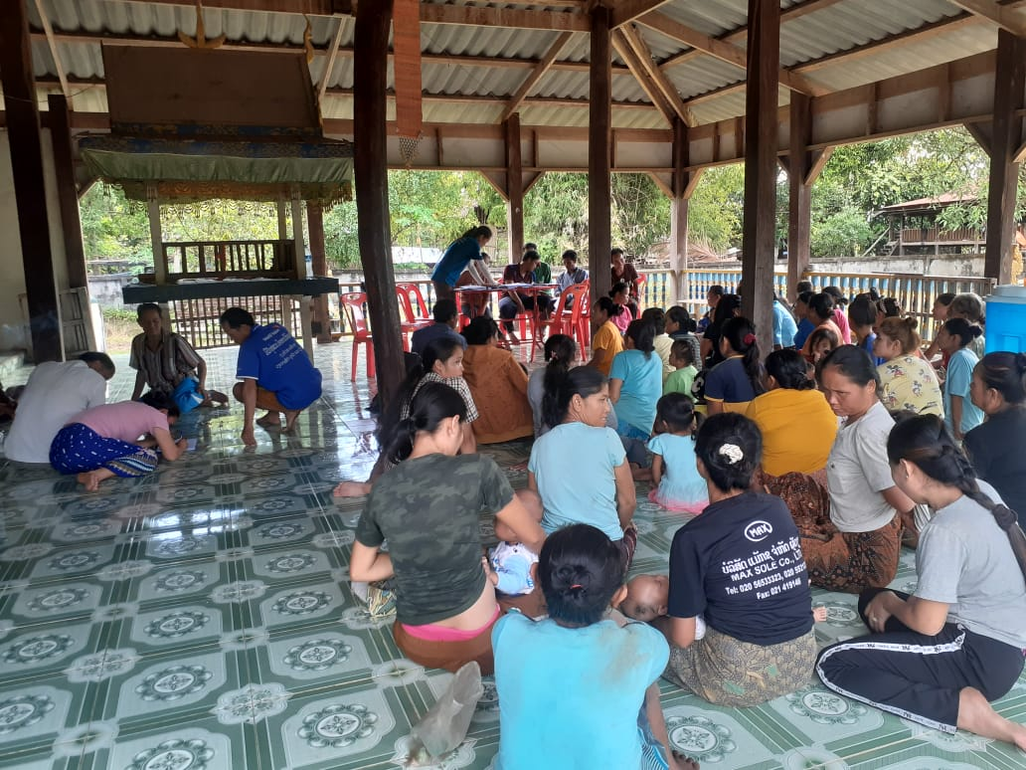
Only 7.9% of Laos’ population has access to clean cooking (WHO, 2019), ranking last in
Asia, behind North Korea with 10.8%. Household air pollution (HAP) is the third-leading
health risk factor for premature deaths in the country (IHME, 2017). The use of dirty
biomass fuels causes over 4,000 deaths annually in Laos, imposing costs equivalent to
5.7 percent of GDP in 2017; their use is the country’s largest identified environmental
health risk (World Bank 2020).

Slide 3
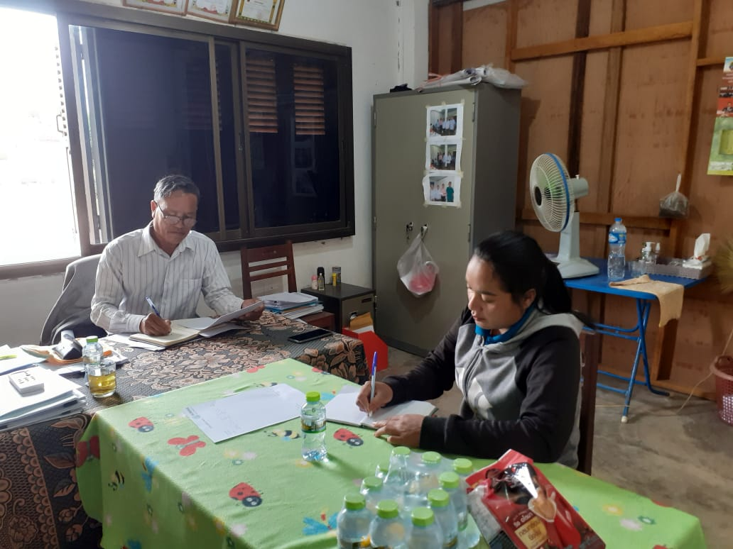
Before the start of the activities meetings were held with the coordinators of The District Agriculture Offices of Gnomalath and Mahaxay, to go through the project objectives

Slide 4
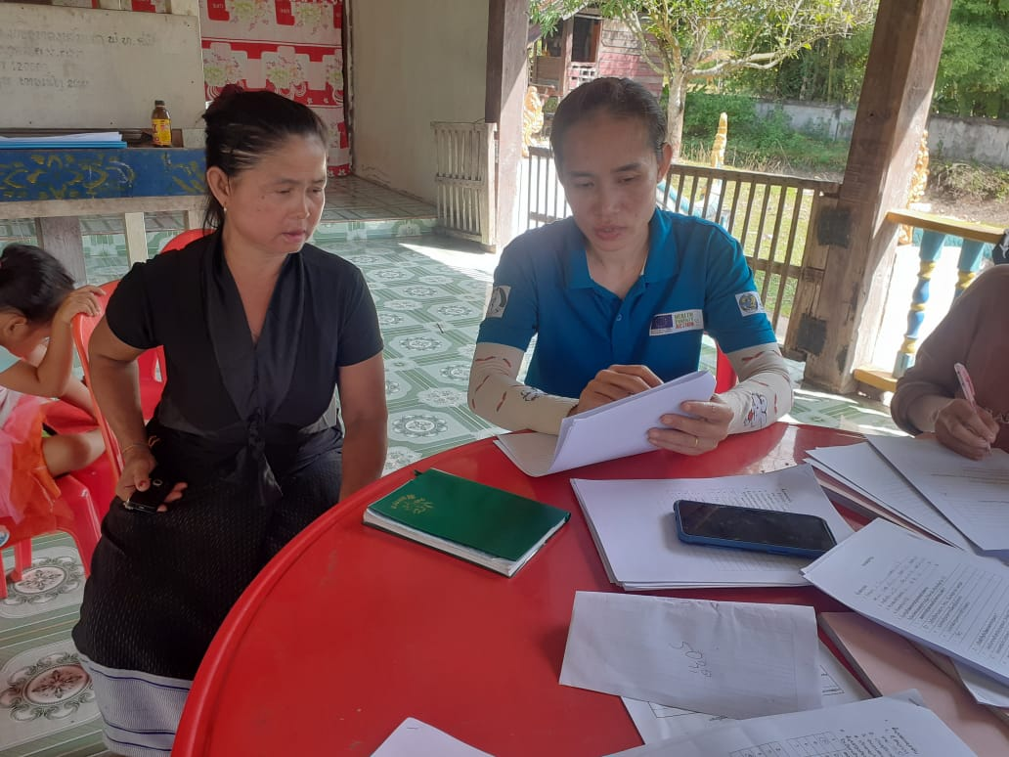
200 women have signed up for the program

Slide 5
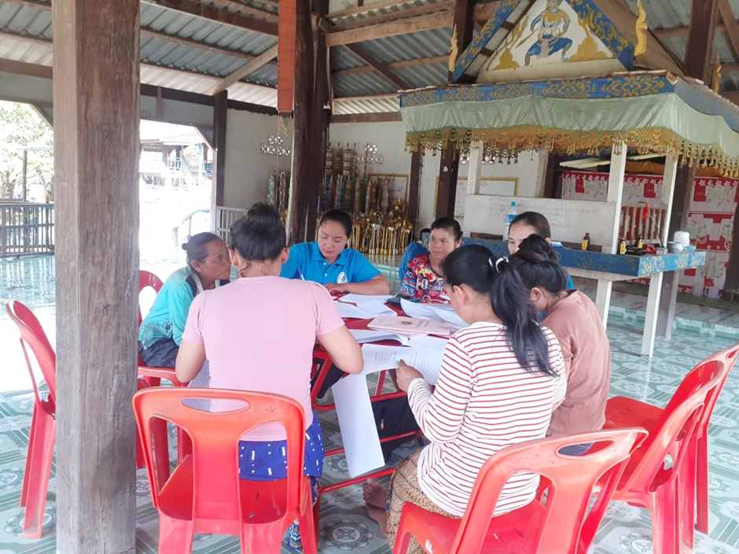
The project’s aim is to improve the health of vulnerable ethnic minority women and
girls in the 4 target villages and develop their skills to champion gender equality and
promote economic empowerment while helping improve community nutrition levels.

Slide 6
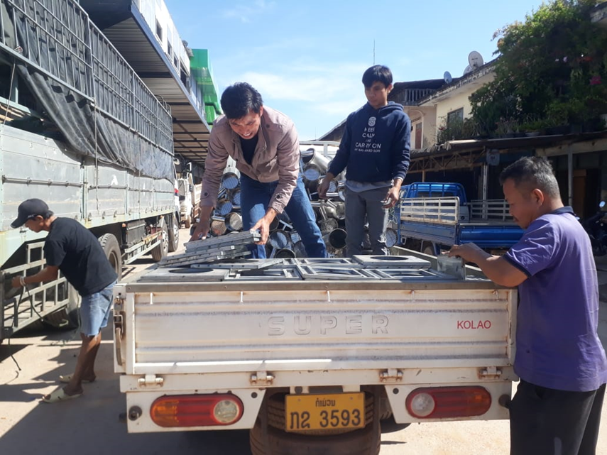
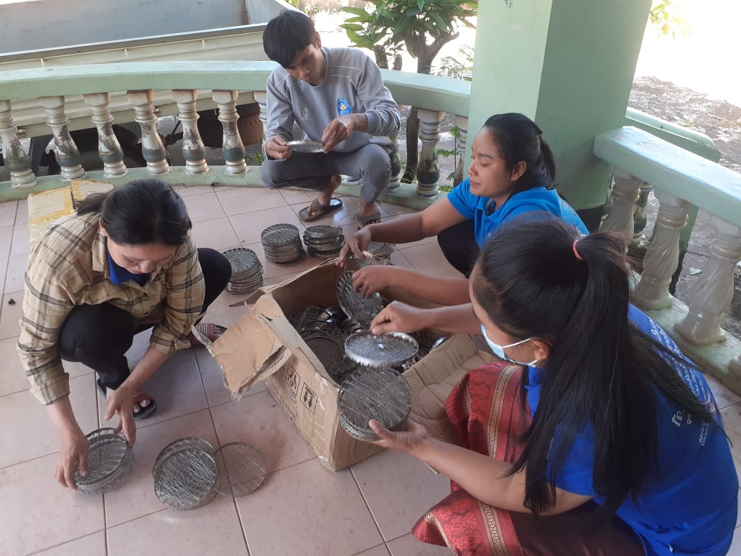
200 Household Biomass Gasifiers were produced in Vietnam and transported to Thakek, in Khammouane Province

Slide 7
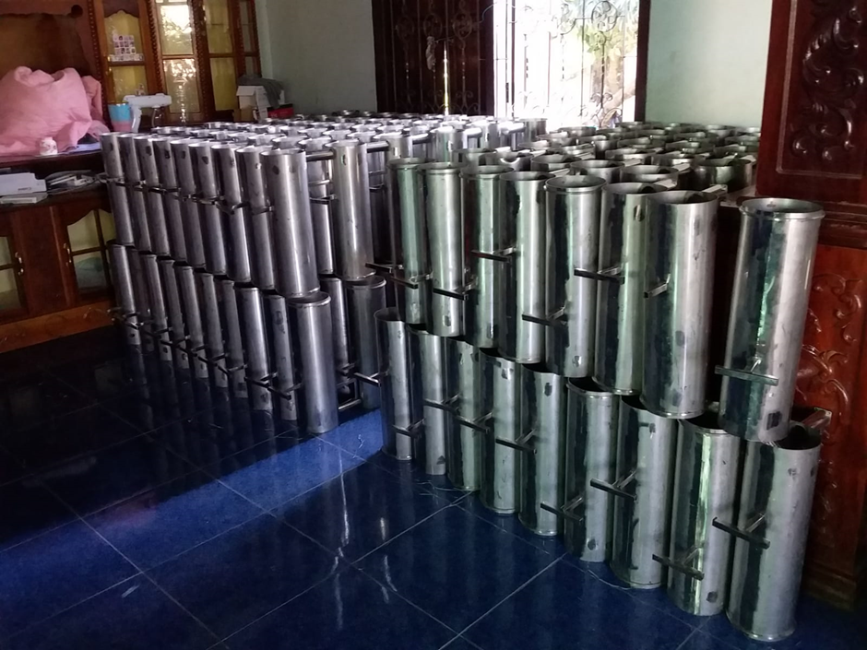

Slide 8
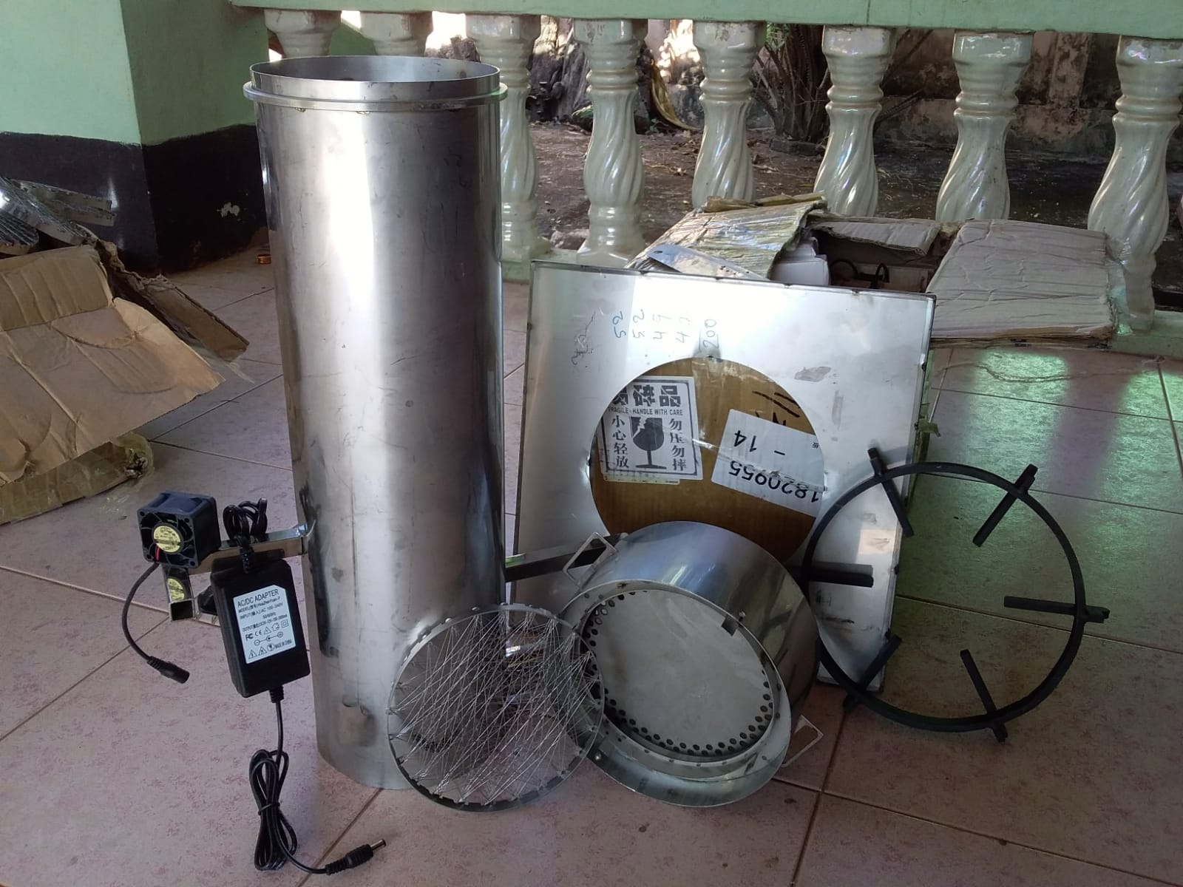
Each of the 200 women will receive a Biomass Gasifiers and learn how to use it

Slide 9
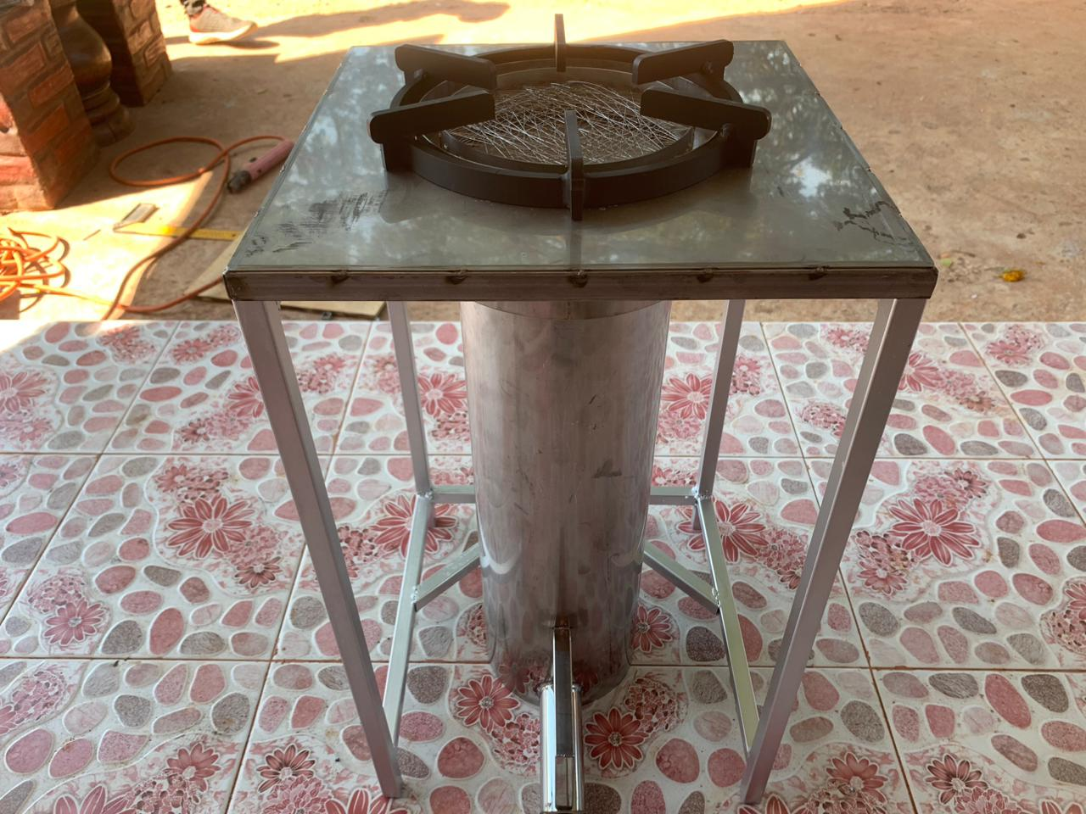
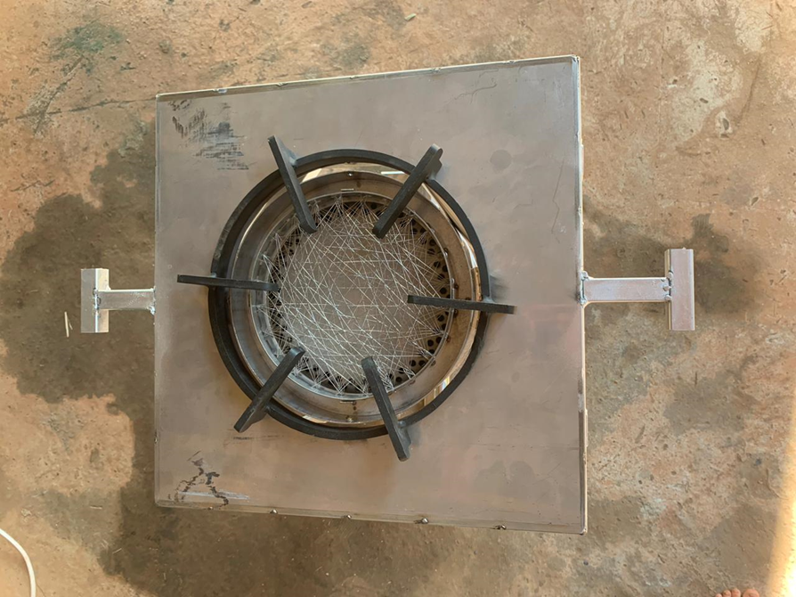
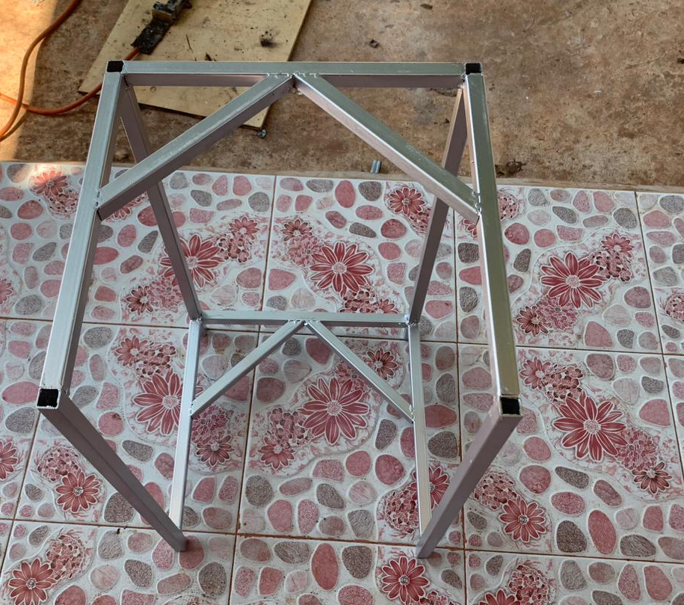
The Gasifier is fueled with rice husk. The husk will gasify in a closed steel canister. A local workshop in Khammouane has produced a steel frame for each gasifier for protection.

Slide 10
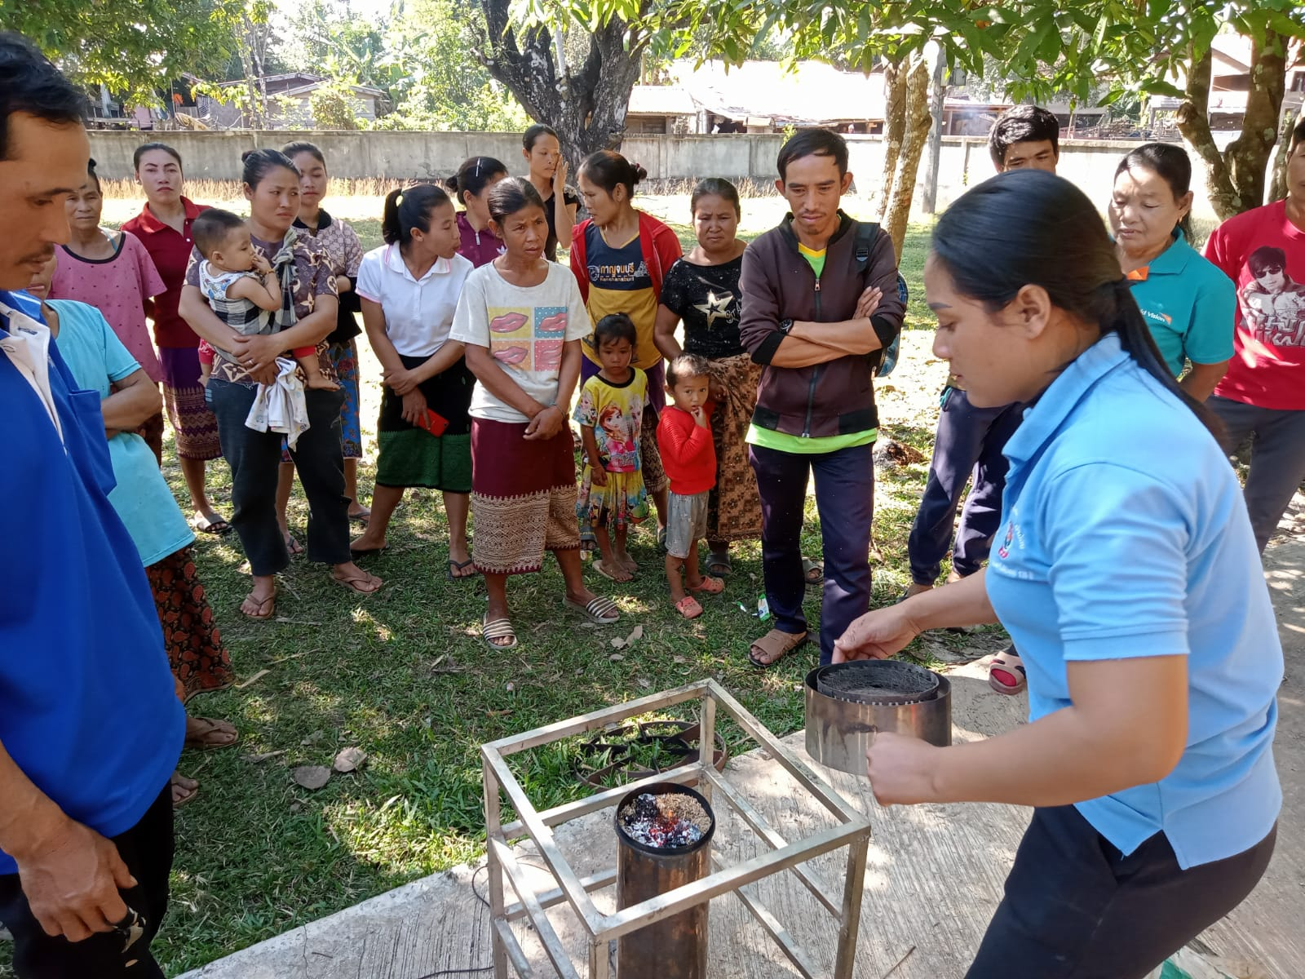
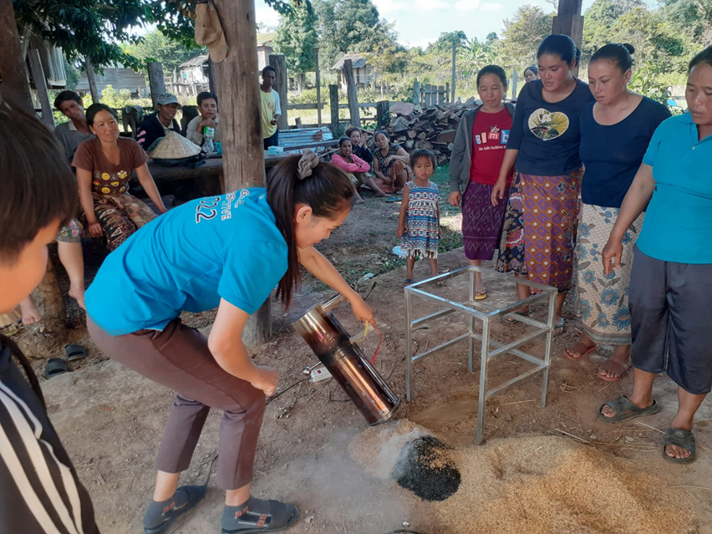
The women and their husbands have been instructed in the use of the Household Biomass Gasifiers and the project has raised awareness about the environmental benefits of the device.

